Slide 2
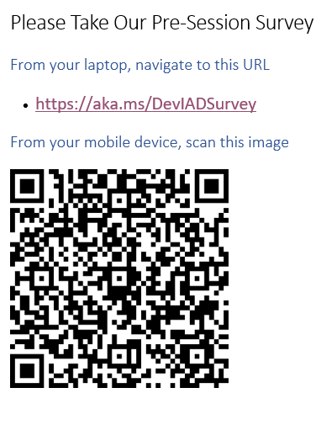
Developing with Power BI Embedding
Session code
Ted Pattison
Developer, Instructor and MVP

Slide 3


Who Is Ted Pattison? ted.pattison@criticalpathtraining.com
Developer, Instructor and Author
14-time MVP – Power BI, PowerApps, Flow and SharePoint
Leader of Tampa PowerApps-Flow User Group
Owner of Critical Path Training
Ted teaches these courses
Power BI Certification Bootcamp
Power BI Developer in a Day
Power BI Developer Bootcamp
Building Business Solutions with PowerApps and Flow
More info at https://www.CriticalPathTraining.com

Slide 4
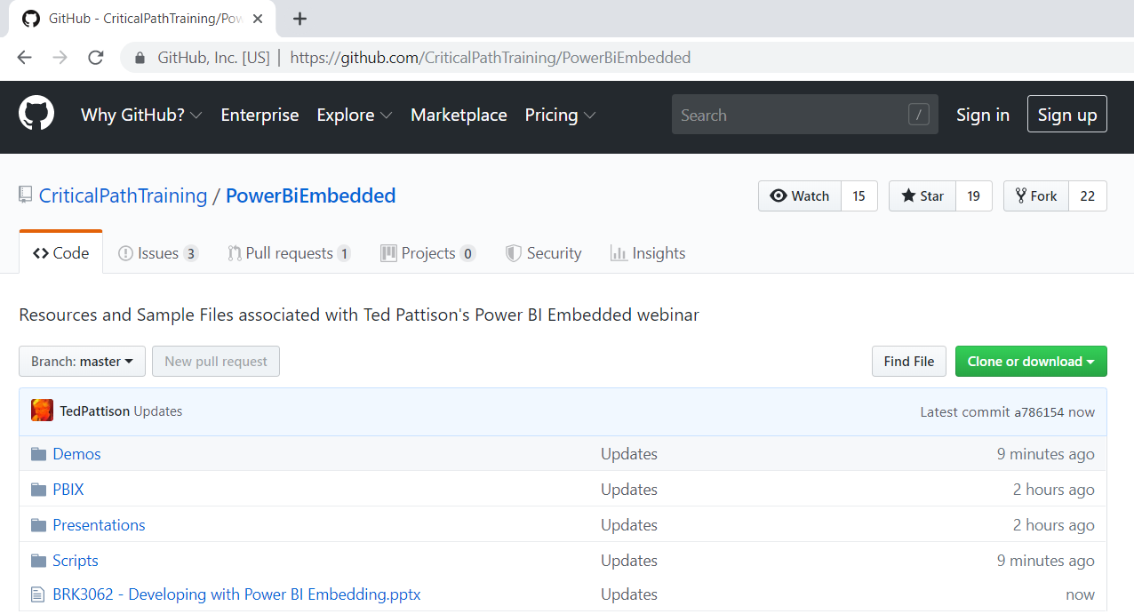
Get the Slides and Sample Code
https://github.com/CriticalPathTraining/PowerBiEmbedded

Slide 5
Agenda
Power BI Embedding Fundamentals
Authentication with Azure AD
Programming the Power BI Service API
App-only Authentication
Single Page Applications (SPAs) with React.js
Programming the Power BI JavaScript API

Slide 6
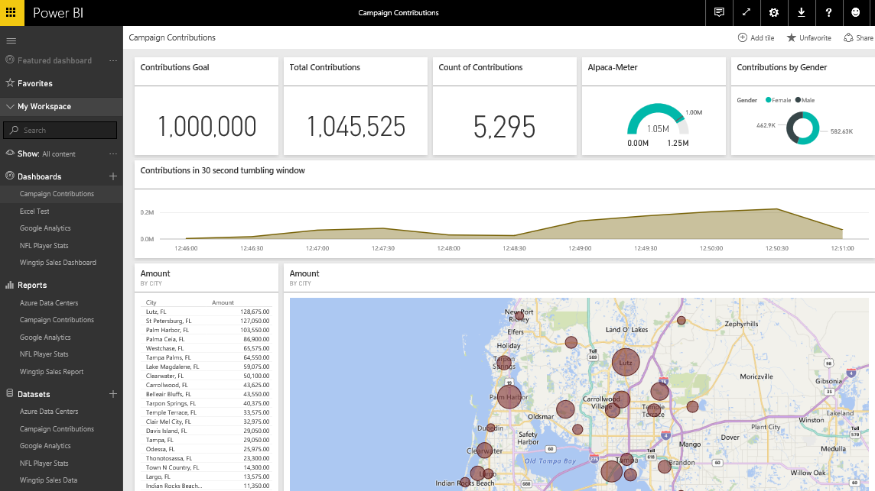
The Power BI Service – Who Is It For?
Provides SaaS service used by web and mobile users
Power BI portal accessible to browsers at https://app.powerbi.com
Power BI mobile accessible to users on mobile phones & devices
Provides PaaS service used by software developers
Power BI Service API accessible at https://api.powerbi.com
Notes:
You can think of the Power BI service as the heart and sole of the Power BI platform. Subscribed users access the Power BI service using any modern browser through its primary URL which is https://app.powerbi.com. Once a user has been authenticated against the common endpoint of https://app.powerbi.com, the users is then connected to the Azure data center which hosts the user’s Power BI workspaces.
Using the browser, a Power BI subscriber can view dashboard and interactive reports. The browser-based experience of the Power BI service also provides support to import datasets and to create reports and dashboards.

Slide 7
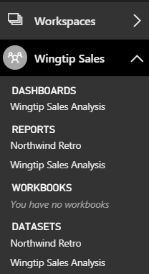
Central Power BI Concepts
Workspace
Secure container for publishing content
Every licensed user gets a personal workspace
App workspaces created for custom solutions
Dashboard
Consolidated view into reports and datasets
Custom solution entry point for mobile users
Report
Collection of pages with tables & visualizations
Provides interactive control of filtering
Dataset
Data model containing one or more tables
Can be very simple or very complex
Notes:
You can think of a workspace as a container that holds three different kinds of assets; dashboards, reports and datasets. Every dashboard, report and dataset created in Power BI must be created within the scope of a specific workspace. A workspace also provides a user context because the current workspace always determines which set of dashboards, reports and datasets are visible to the user.
Every Power BI subscriber has a personal workspace which is named My Workspace. An organization can also create group workspaces which make it possible to achieve team-based authoring and staged deployment of custom solutions. The course will go into greater detail on working with group workspaces later in module 7 when discussing how to deploy dashboards.
A dashboard typically serves as the top-level entry point into a custom data analytics solution. In Power BI, a dashboard is created as a consolidated view on top of reports and datasets. Dashboard are also important to Power BI mobile users because there display is often optimized for mobiles devices such as iPhones, Android phones and Windows 10 phone.
A report is a collection of pages that is associated with exactly one underlying dataset. Each page in a report serves as a canvas on which you can add tables, matrices and other types of visualizations. While dashboards are designed to provide a high-level overview, reports are the opposite because they are used to drill down into the lower-level details. Reports also provide much more interactive filtering control for custom solutions in which the user must be given the ability to drill down into further levels of detail.
A dataset is a collection of one of more tables that defines a data model. A simple dataset can contain a single table with three columns and ten rows. However, a dataset often contains multiple tables which has relationships between them. In the upcoming lab exercises in this course, you will design a dataset using all the different query and data modeling features of Power BI Desktop.

Slide 8
Power BI Embedding – The Big Picture
User launches your app using a browser
App authenticates with Azure Active Directory and obtains access token
App uses access token to call to Power BI Service API
App retrieves data for embedded resource and passes it to browser.
Client-side code uses Power BI JavaScript API to create embedded resource
Embedded resource session created between browser and Power BI service
5
Power BI Service
Browser
iFrame
6
4
4
3
1
Your App
2
Azure AD

Slide 9
First Party Embedding vs Third Party Embedding
First Party Embedding
Known as User-Owns-Data Model
All users require a Power BI license
Useful in corporate environments
App authenticates as current user
Your code runs with user’s permissions
User’s access token passed to browser
Third Party Embedding
Known as App-Owns-Data Model
No users require Power BI license
Useful for commercial applications
App authenticates with app-only identity
Your code runs with admin permissions
Embed token passed to browser
First Party Embedding for use within Organization
Third Party Embedding for use by ISVs
Browser
Power BI Service
Browser
Power BI Service
iFrame
iFrame
Azure AD
Access Token
for the current user
Power BI
Embed Token
for specific report

Slide 10
Embeddable Resources
Reports
Dashboards
Dashboard Tiles
New Reports
Q&A Experience
Visuals in custom layout

Slide 11
The Power BI Embedded from the User Perpsective

Slide 12
Agenda
Power BI Embedding Fundamentals
Authentication with Azure AD
Programming the Power BI Service API
App-only Authentication
Single Page Applications (SPAs) with React.js
Programming the Power BI JavaScript API

Slide 13
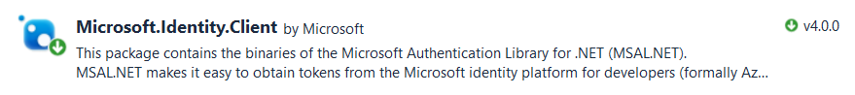
Azure AD Endpoints and Libraries
Authenticating with the Azure AD V1 Endpoint
Heavily used over the last 5-6 years
Accessed through Azure AD Authentication Library (ADAL)
Authenticating with the Azure AD V2 Endpoint
Moved from preview to GA in May 2019
Accessed through Microsoft Authentication Library (MSAL)
Why move to the Azure AD V2 Endpoint?
Dynamic Incremental consent
New authentication flows (e.g. device code flow)

Slide 14
Authentication Flows
User Password Credential Flow (public client)
Used in Native clients to obtain access code
Requires passing user name and password across network
Device Code Flow (public client)
New style of authentication introduced with Azure AD v2 Endpoint
Client Credentials Flow (confidential client)
Authentication based on password or certificate held by application
Used to obtain app-only access tokens
Authorization Code Flow (confidential client)
Client first obtains authorization code sent back to browser
Client then obtains access token in server-to-server call
Implicit Flow (public client)
Used in SPAs built with JavaScript and AngularJS
Application obtains access token w/o acquiring authorization code

Slide 15
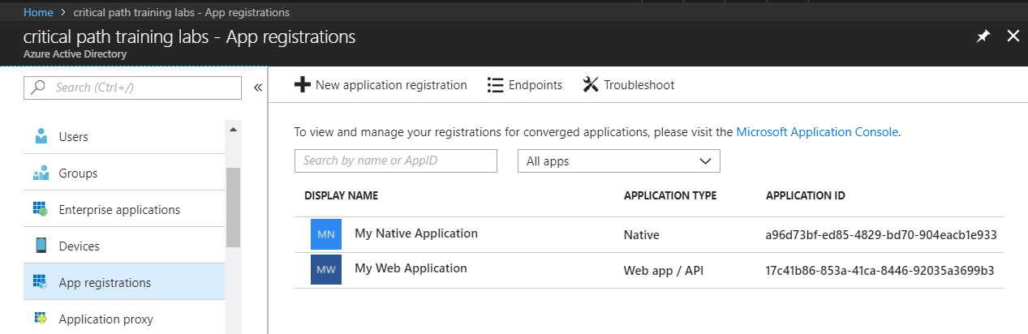
Azure AD Applications
Creating applications required for AAU authentication
Applications are as Native application or Web Applications
Application identified using GUID known as application ID
Application ID often referred to as client ID or app ID

Slide 16
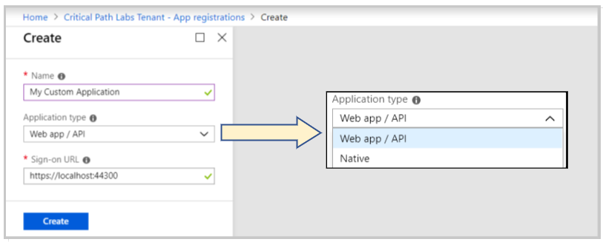
Application Types
Azure AD Application Types
Native clients
Web app / API client

Slide 17
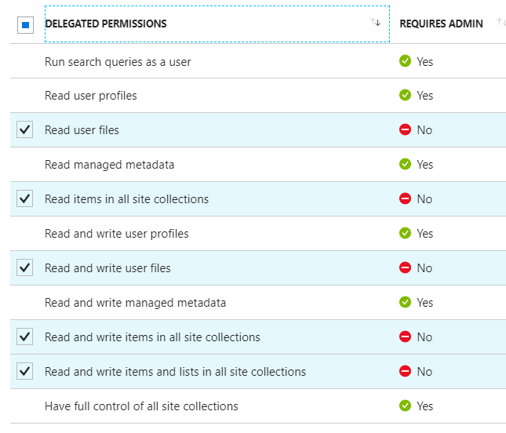
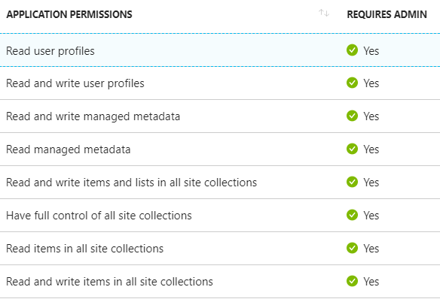
Delegated Permissions vs Application Permissions
Permissions categorized into two basic types
Delegated permissions are (app + user) permissions
Application permissions are app-only permissions (far more powerful)
Not all application types and APIs support application permissions
Power BI Service API does not yet support application permissions
Example permissions for Office 365 SharePoint Online
Some delegated permissions requires administrative permissions

Slide 18
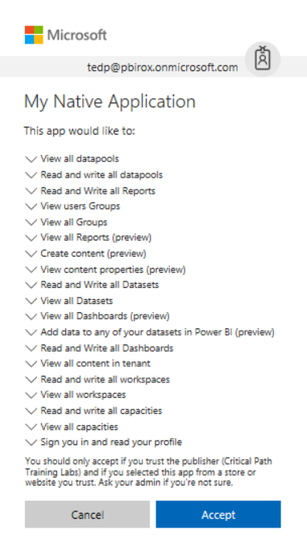
Interactive Consent for Delegated Permissions
Users must consent to delegated permissions
User prompted during first log in
User must click Accept
Only occurs once for each user

Slide 19
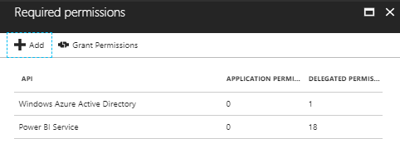
Granting Delegated Permissions
It can be helpful to Grant Permissions in Azure portal
Prevents the need for interactive granting of application by user
Might be required when authenticating in non-interactive fashion

Slide 20
AAD Security Principals
Azure AD creates service principal for application
Service principle created once per tenant
Service principle used to track permission grants
AAD creates service principal on demand when first needed
You can create service principal in PowerShell script
Host Tenant
Tenant 2
Tenant 3
Application
Application ID
Service Principal
Object ID
Service Principal
Object ID
Service Principal
Object ID
Permission Grants
User1
User2
Permission Grants
User1
User2
Permission Grants
User1
User2

Slide 21
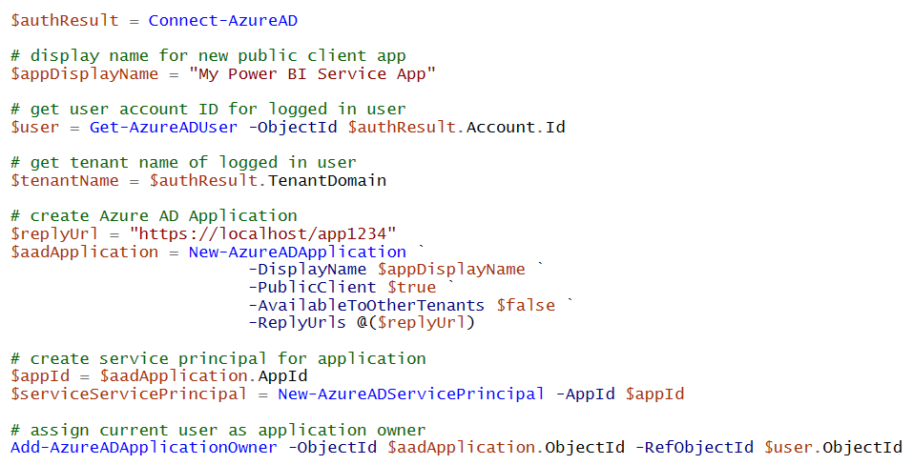
Registering AAD Apps with PowerShell

Slide 22
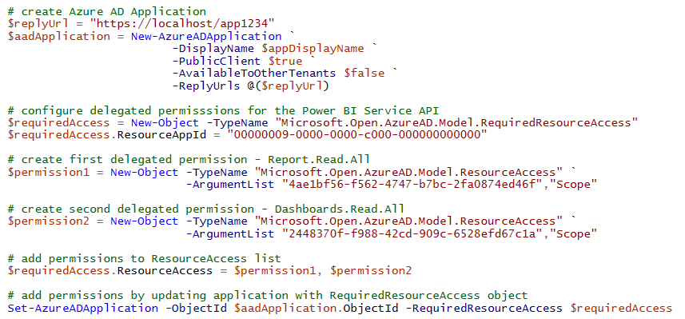
Configuring Delegated Permissions

Slide 23
Registering an Azure AD Application using PowerShell

Slide 24
Agenda
Power BI Embedding Fundamentals
Authentication with Azure AD
Programming the Power BI Service API
App-only Authentication
Single Page Applications (SPAs) with React.js
Programming the Power BI JavaScript API

Slide 25
What Is the Power BI Service API?
What is the Power BI Service API?
API built on OAuth2, OpenID Connect, REST and ODATA
API secured by Azure Active Directory (AAD)
API to program with workspaces, datasets, reports & dashboards
API also often called “Power BI REST API”
What can you do with the Power BI Service API?
Publish PBIX project files
Update connection details and datasource credentials
Create workspaces and clone content across workspaces
Embed Power BI reports and dashboards tiles in web pages
Create streaming datasets in order to build real-time dashboards

Slide 26
User APIs versus Admin APIs
Power BI User APIs (e.g. GetGroupsAsync)
provides users with access to personal workspace
provides users with access to app workspaces
provides service principal (SP) with access to app workspaces
Power BI Admin APIs (e.g. GetGroupsAsAdminAsync)
provides users with tenant-level access to all workspaces
does not currently support app-only authentication

Slide 27
Authenticating with Azure AD
Custom applications must authenticate with Azure AD
Your code implements and authentication flow to obtain access token
Access token must be passed when calling Power BI Service API
Microsoft supports two endpoints for programming authentication
Azure AD V1 endpoint (released to GA over 8 years ago)
Azure AD V2 endpoint (released to GA in May 2019)
Azure Active Directory
Custom App
Access Token
Access Token
Power BI Service

Slide 28
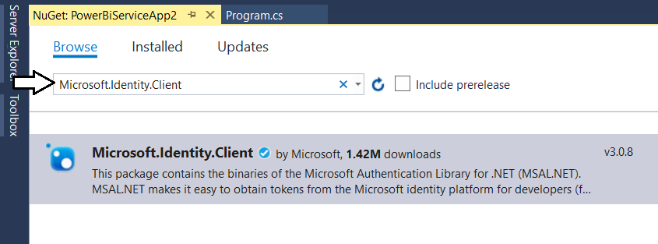
Microsoft Authentication Library (.NET)
Developing with the Microsoft Authentication Library
Provides access to Azure AD V2 Endpoint
Added to project as Microsoft.Identity.Client NuGet package
Provides different classes for public clients vs confidential clients

Slide 29
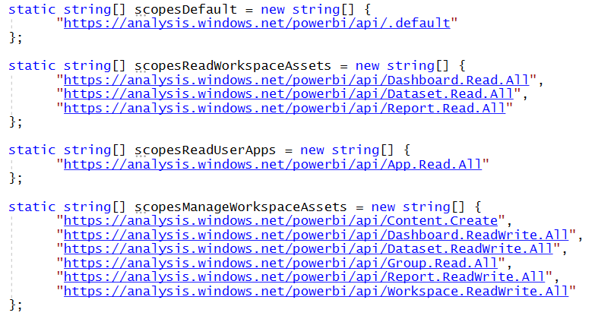
Power BI Service API Scopes
Azure AD V2 endpoint requires passing scopes
Scopes define permissions required in access token
Scopes defined as resource + permission https://analysis.windows.net/powerbi/api/ + Report.ReadWrite.All

Slide 30
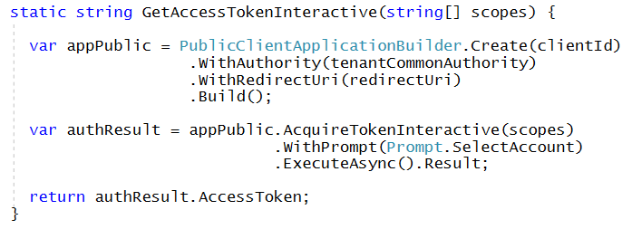
Interactive Access Token Acquisition Using MSAL with public client application
Flow implemented using PublicClientApplication object
Created using PublicClientApplicationBuilder object
Requires passing redirect URI
You can control prompting behavior

Slide 31
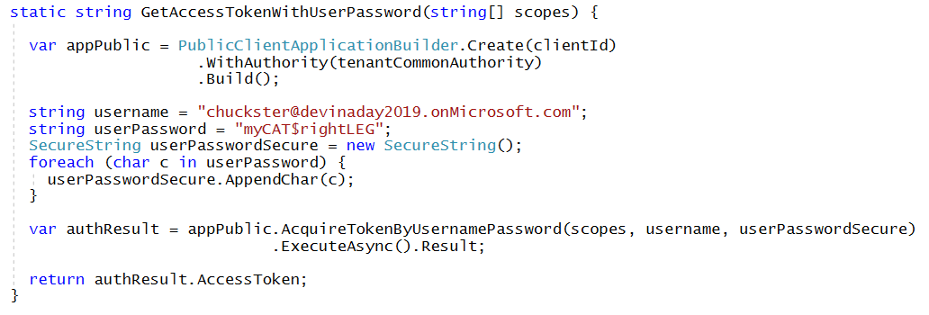
User Credential Password Flow Using MSAL with public client application
MSAL supports user credential password flow
Supported in .NET runtime but not in .NET CORE
Microsoft recommends against using this flow

Slide 32
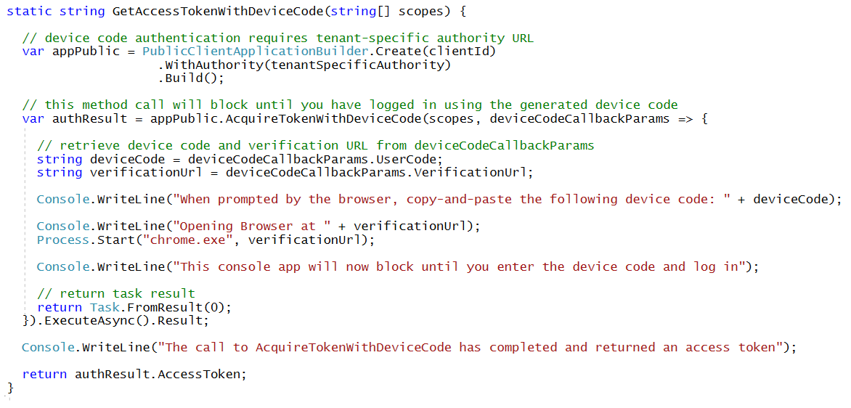
Device Code Flow Using MSAL with public client application
MSAL introduced this new flow with MSAL
Much more secure than user password credential flow
Not available in ADAL

Slide 33
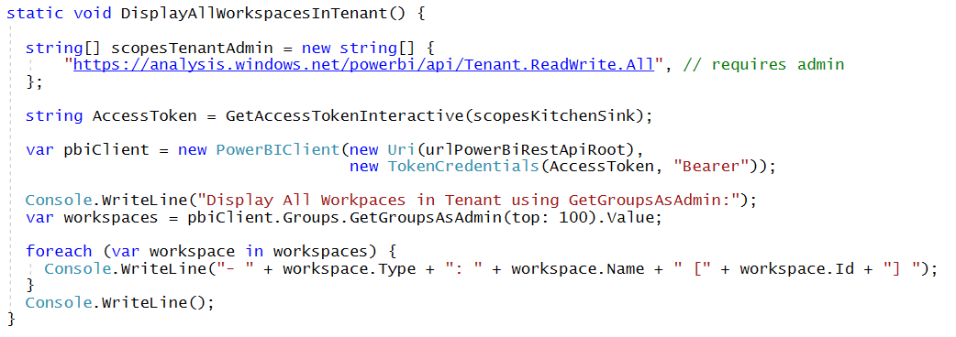
Calling into the Power BI Admin API
Admin API exposed using AsAdmin methods
Example:
Makes it possible to access every workspace in current tenant
Requires access token for user who is tenant or Power BI admin

Slide 34
Power BI .NET SDK
Developing without the Power BI .NET SDK
Developing with the Power BI .NET SDK
Your C# Code
Power BI
Service API
Executing HTTP Requests
Capturing HTTP Responses
Serializing/Deserializing JSON
Your C# Code
Power BI
Service API
Power BI .NET SDK
Executing HTTP Requests
Capturing HTTP Responses
Serializing/Deserializing JSON

Slide 35
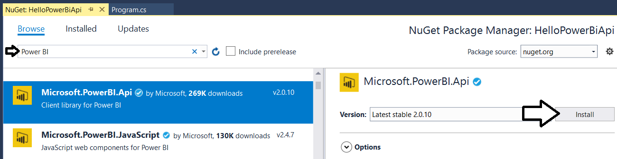
Power BI .NET SDK
Added as a NuGet package
Your C# Code
Power BI
Service API
Power BI .NET SDK
Executing HTTP Requests
Capturing HTTP Responses
Serializing/Deserializing JSON

Slide 36
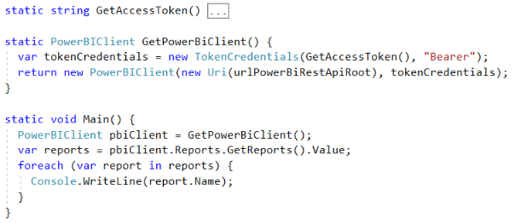
Initializing an Instance of PowerBIClient
PowerBIClient object serves as top-level object
Used to execute calls against Power BI Service
Initialized with function to retrieve AAD access token

Slide 37
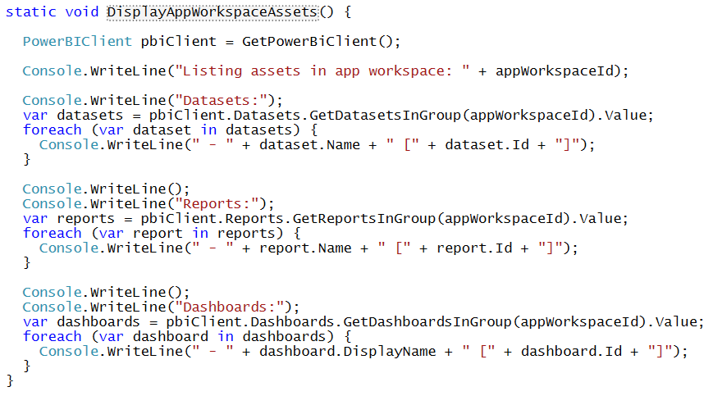
Enumerating Collections with PowerBiClient

Slide 38
Agenda
Power BI Embedding Fundamentals
Authentication with Azure AD
Programming the Power BI Service API
App-only Authentication
Single Page Applications (SPAs) with React.js
Programming the Power BI JavaScript API

Slide 39
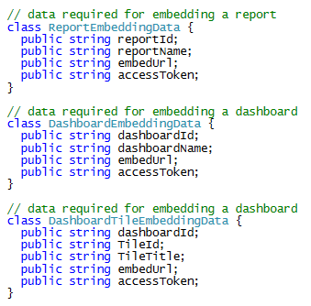
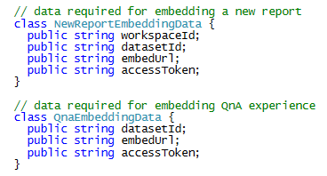
Report and Dataset Info

Slide 40
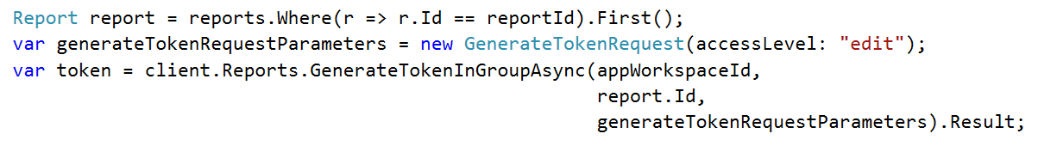
Embed Tokens
You can embed reports using master user AAD token, but…
You might want embed resource using more restricted tokens
You might want stay within the bounds of Power BI licensing terms
You generate embed tokens with the Power BI Service API
Each embed token created for one specific resource
Embed token provides restrictions on whether user can view or edit
Embed token can only be generated in dedicated capacity (semi-enforced)
Embed token can be generated to support row-level security (RLS)

Slide 41
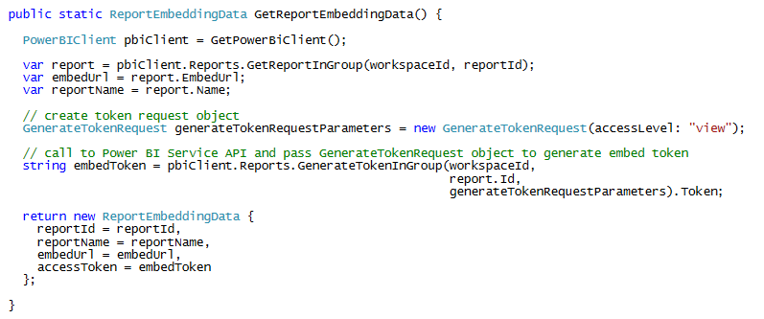
Data for Third Party Report Embedding

Slide 42
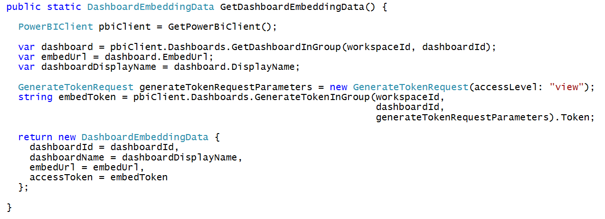
Getting the Data for Dashboard Embedding

Slide 43
App-only Access Control
Service Principal used to configure access control
Requires the use of v2 app workspaces
Service principal added to app workspaces as admin
Access control NOT based on Azure AD permissions
App Workspace 1
Admins
User 1
User 2
App 1 Service Principal
Power BI Service
App 1 Service Principal
App-only Access Token
App Workspace 2
Admins
User 1
App 1 Service Principal
App 2 Service Principal

Slide 44
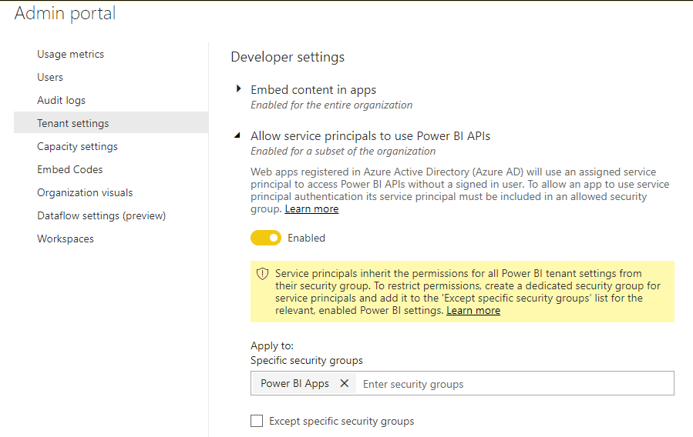
Tenant Setup
Your Power BI Tenant
These serviced principals now have access to the User APIs
Power BI Enabled
Service Principals
Service Principal
Application 1
Security Group
Power BI Apps
Service Principal
Application 2
Service Principal
Application 3

Slide 45
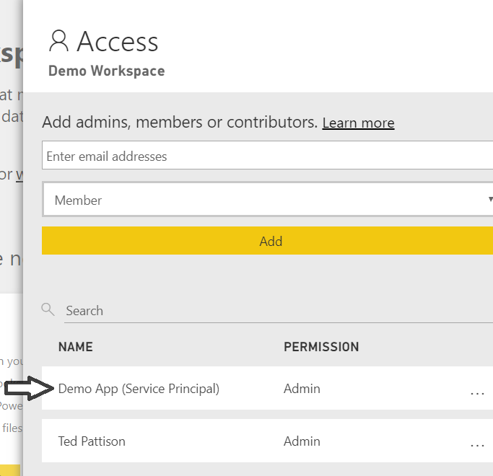
App-only Access with PBI Service API
Service Principal added to workspace as admin
Only works with v2 app workspaces
Provides full workspace access to service principal

Slide 46
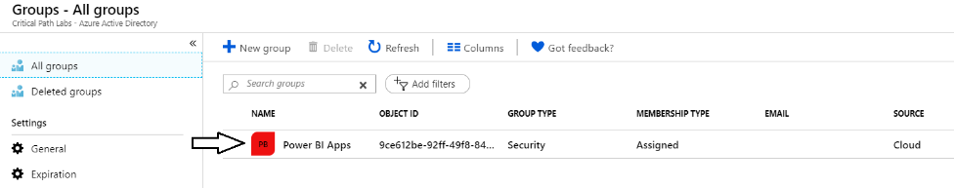
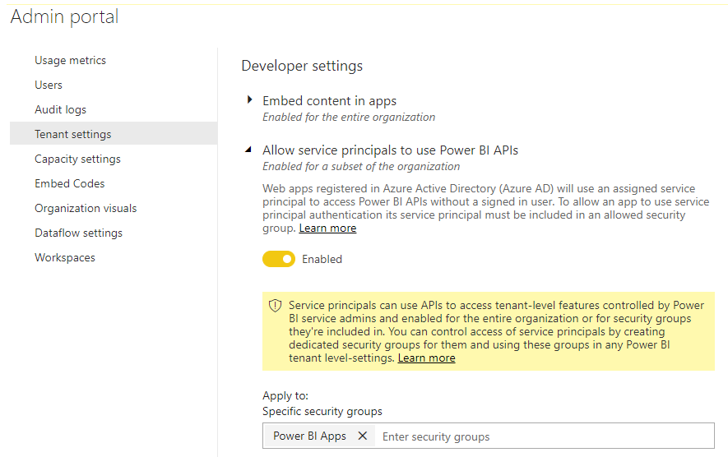
Setting Up for App-Owns-Data – Part 1
Enable Service Principal Access to Power BI Service API
Create an Azure AD security group (e.g. Power BI Apps)
Add group to Power BI Allow service principals to use Power BI APIs

Slide 47
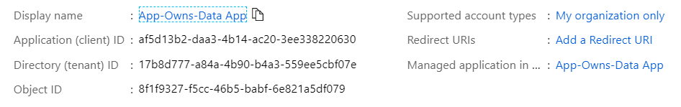
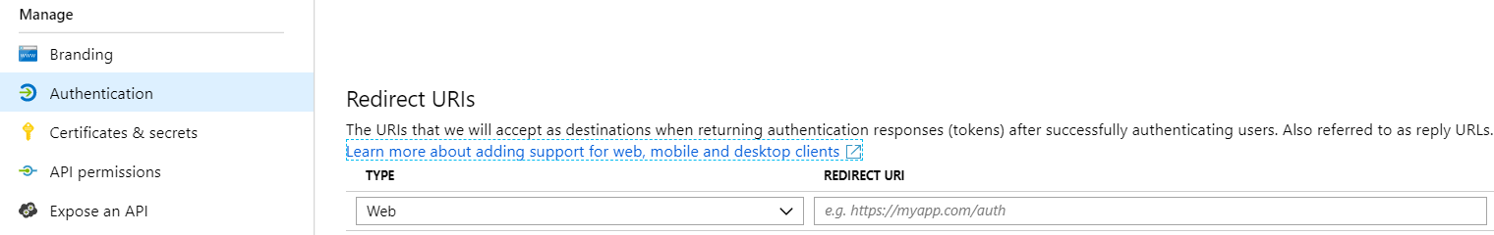
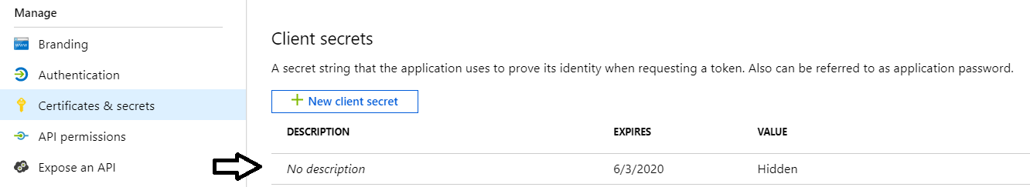
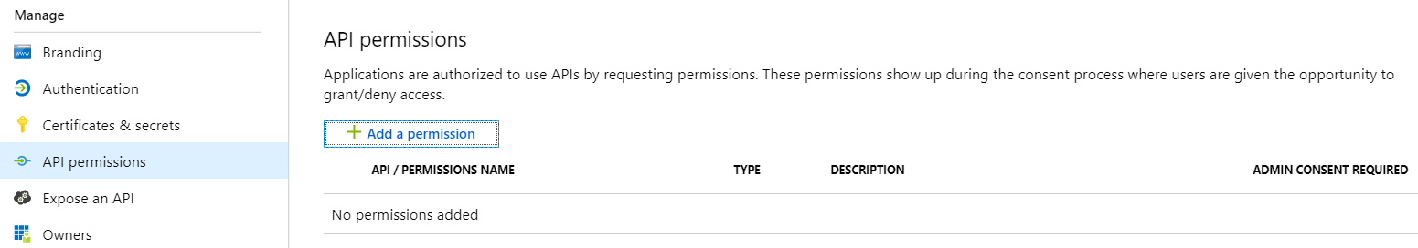
Setting Up for App-Owns-Data – Part 2
Create a confidential client in your Azure AD tenant
Configured as TYPE=Web and no need for a redirect URL
Add a client secret or a client certificate
No need to configure any permissions

Slide 48
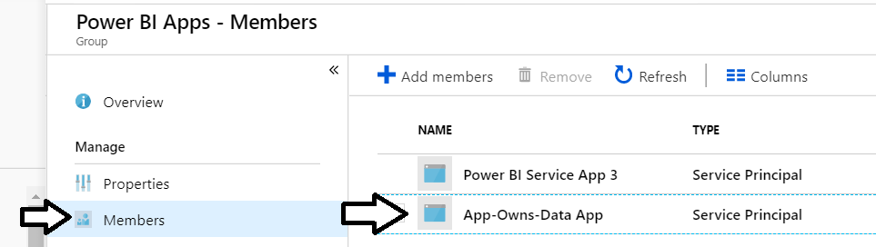
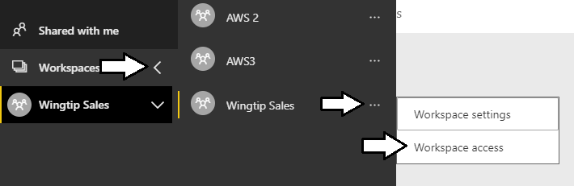
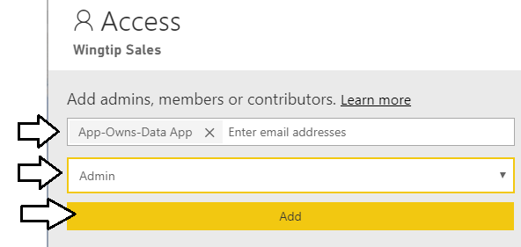
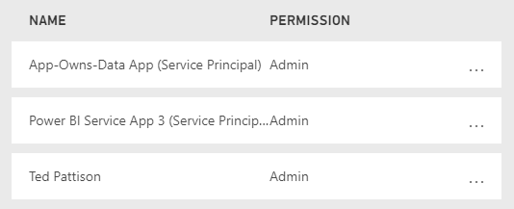
Setting Up for App-Owns-Data – Part 3
Add application's service principal in Power BI Apps security group
Configure application's service principal as workspace admin
Service principal should now be workspace admin

Slide 49
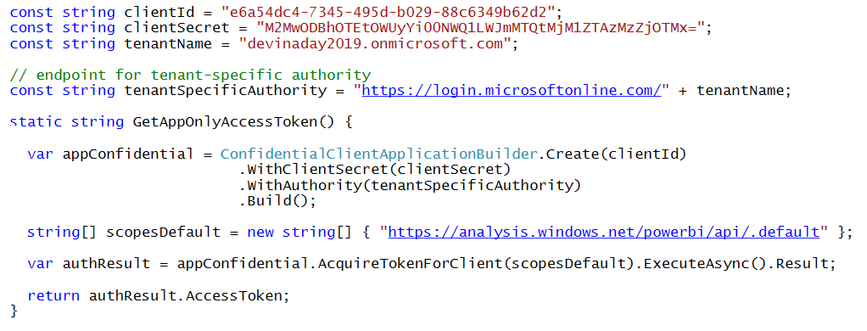
Client Credentials Flow Using MSAL with confidential client application
Client credentials flow used to obtain app-only token
Requires passing app secret (e.g. app password or certificate)
Requires passing tenant-specific endpoint

Slide 50
Examining the ThirdPartyEmbeddingApp

Slide 51
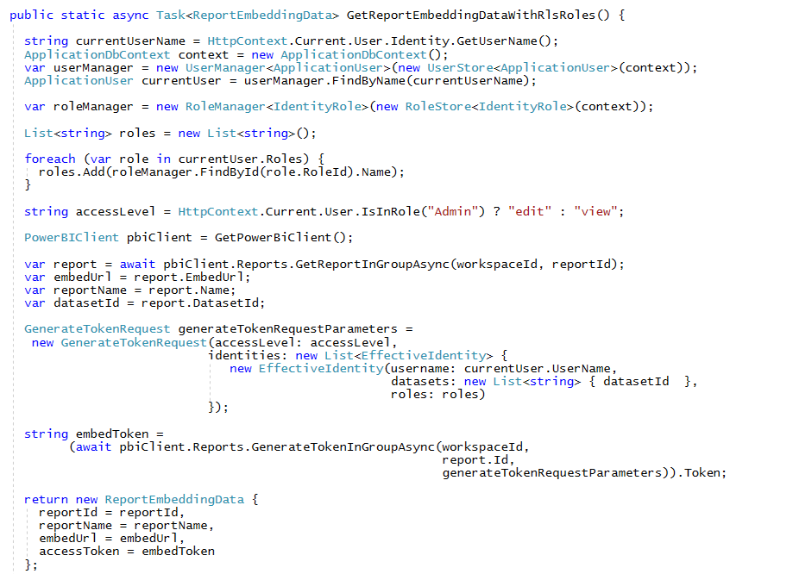
Working with RLS Roles and EffectiveIdentity

Slide 52
Examining the RowLevelSecurityDemo

Slide 53
Agenda
Power BI Embedding Fundamentals
Authentication with Azure AD
Programming the Power BI Service API
App-only Authentication
Single Page Applications (SPAs) with React.js
Programming the Power BI JavaScript API

Slide 54
Examining the PowerBiDaySpa

Slide 55
Examining the UserOwsDataConsumerApp

Slide 56
Agenda
Power BI Embedding Fundamentals
Authentication with Azure AD
Programming the Power BI Service API
App-only Authentication
Single Page Applications (SPAs) with React.js
Programming the Power BI JavaScript API

Slide 57
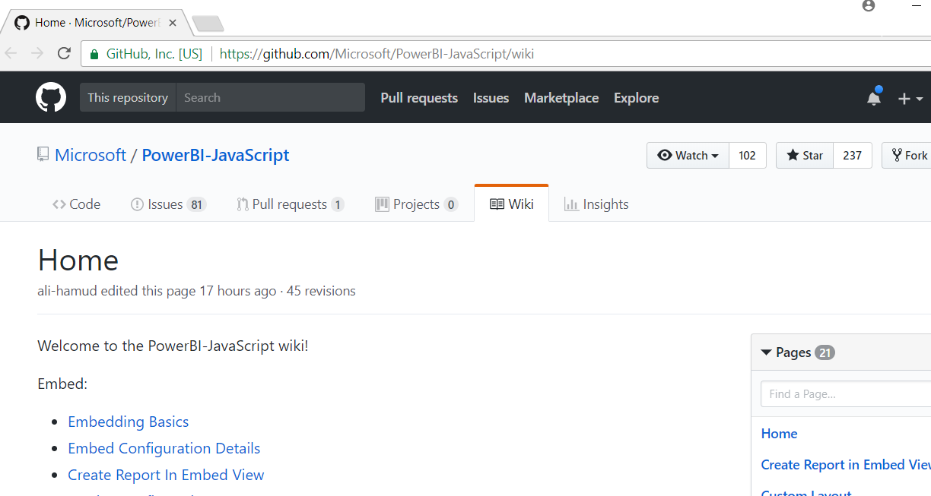
Power BI JavaScript API (powerbi.js)
Power BI JavaScript API used to embed resources in browser
GitHub repo at https://github.com/Microsoft/PowerBI-JavaScript/wiki
GitHub repository contains code, docs, wiki and issues list

Slide 58
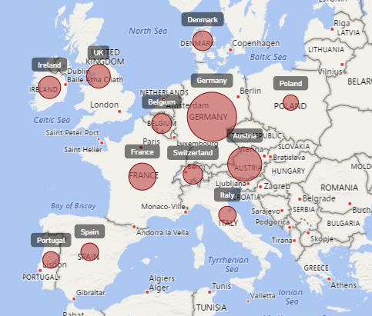
Report Embedding Architecture
Embedding involves creating an iFrame on the page
PBIJS transparently creates iFrame and sets source to Power BI Service
The iFrame and hosting page originate from different DNS domains
Your HTML and CSS
https://app1.mydomain.com
Web Hosting Server
Your
JavaScript
iFrame
Embedding Data
https://wabi-us-east2-redirect.analysis.windows.net/
powerbi.js
Power BI Service

Slide 59
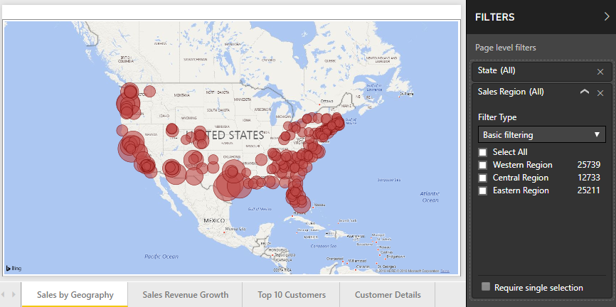
Post Message Communications Flow
4 extra libraries used communicate with report in iFrame
window-post-message-proxy (WPMP)
http-post-message (HPM)
powerbi-router (PBIR)
powerbi-models (PBIM)
iFrame
Your
JavaScript
service
report
HPM
PBIR
WPMP
WPMP
PBIR
HPM

Slide 60
A Promise-based Programming Model
Design of PBIJS simulates HTTP protocol
Creates more intuitive programming model for developers
Programming based on asynchronous requests and promises
Embedded objects programmed using actions and events
Actions
report.fullscreen
report
report.switchMode
report.setFilters
Your
JavaScript
report.getPages
Events
report.loaded
report.pageChanged
report.commandTriggered

Slide 61
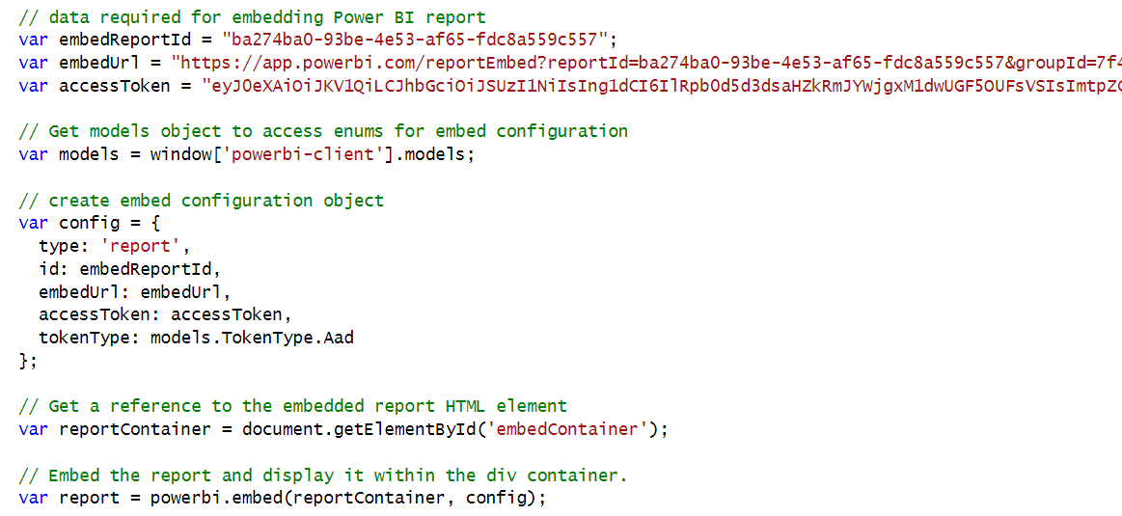
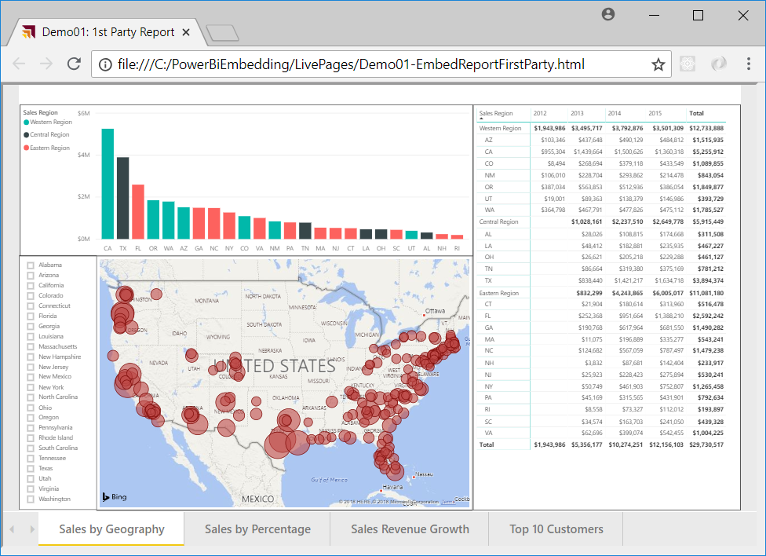
Hello World with Power BI Embedding
powerbi.js library provides powerbi as top-level service object
You call powerbi.embed and pass configuration object with access token
models object available to supply configuration settings
configuration object sets tokenType to either TokenType.Embed or TokenType.Aad
First party embedding

Slide 62
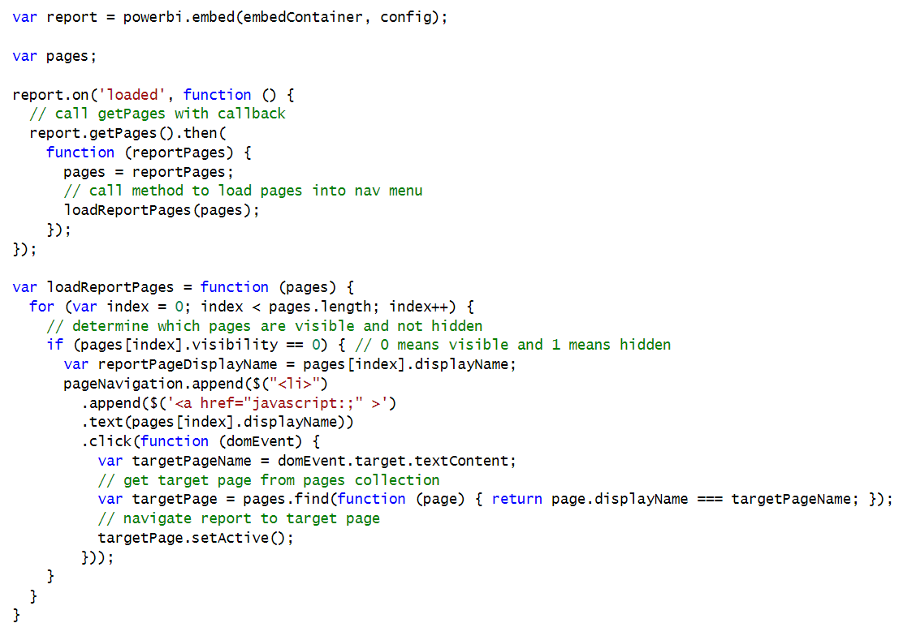
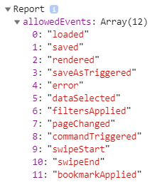
Handling Report Events

Slide 63
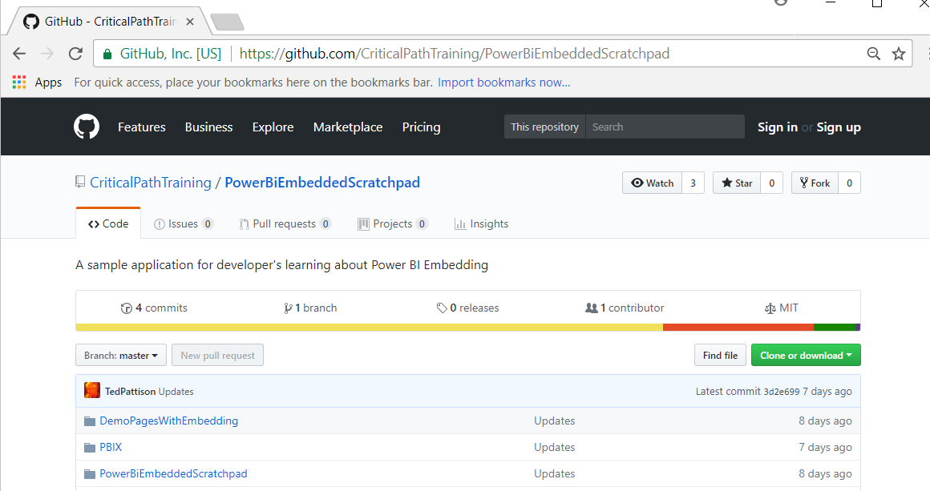
PowerBiEmbeddedScratchpad Sample
https://github.com/CriticalPathTraining/PowerBiEmbeddedScratchpad

Slide 64
The Power BI Embedded Scratchpad App

Slide 65
Summary
Power BI Embedding Fundamentals
Authentication with Azure AD
Programming the Power BI Service API
App-only Authentication
Single Page Applications (SPAs) with React.js
Programming the Power BI JavaScript API

Slide 66
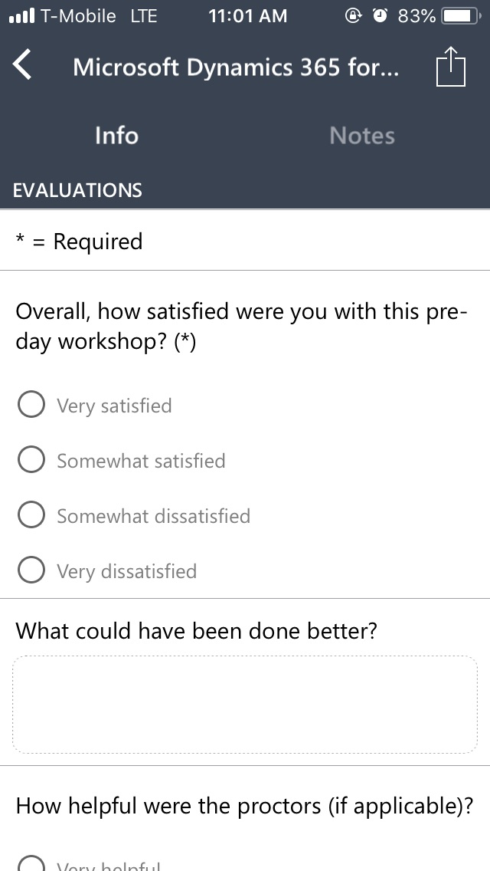
Evaluate this session
Complete your session and conference evaluations through the mobile app or https://aka.ms/MBASeventapp
Please select Microsoft Business Applications Summit from the menu of events and then log in with your registration credentials

